Slide 1
Alfie’s Very Busy Day Self Control and Dignity

Slide 2
Alfie is very hungry.
In family dining today there will be pizza and sweetcorn and tomatoes.
That is Alfie’s favourite!

Slide 3
Alfie was so excited that he went straight from the carpet to the line.
He wanted to get to the hall as quickly as possible!
How could Alfie have shown his self control and dignity?

Slide 4
After washing his hands, Alfie ran as fast as he could to be first in the lunch line.
All he could think of was the pizza!
How could Alfie have shown his self control and dignity?

Slide 5
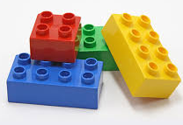
After lunch, Alfie and Freddy were just about to start playing with lego. They were going to build a boat.
Suddenly Alfie felt a tickle in his nose.
A….A….A…Chooo!
Alfie sneezed.

Slide 6
“Hurry up Alfie, I want to build a boat!”
called Freddy.
So Alfie wiped his nose on his sleeve and went over to help Freddy with the lego.
How could Alfie have shown his self control and dignity?

Slide 7
Alfie and Freddy made an amazing boat with the lego.
His teacher Miss Virtue was in the middle of
reading with some other pupils, but Alfie
thought she should see the boat immediately…..

Slide 8
“Miss Virtue, look what we made!”
.
How could Alfie have shown his self control and dignity?

Slide 9
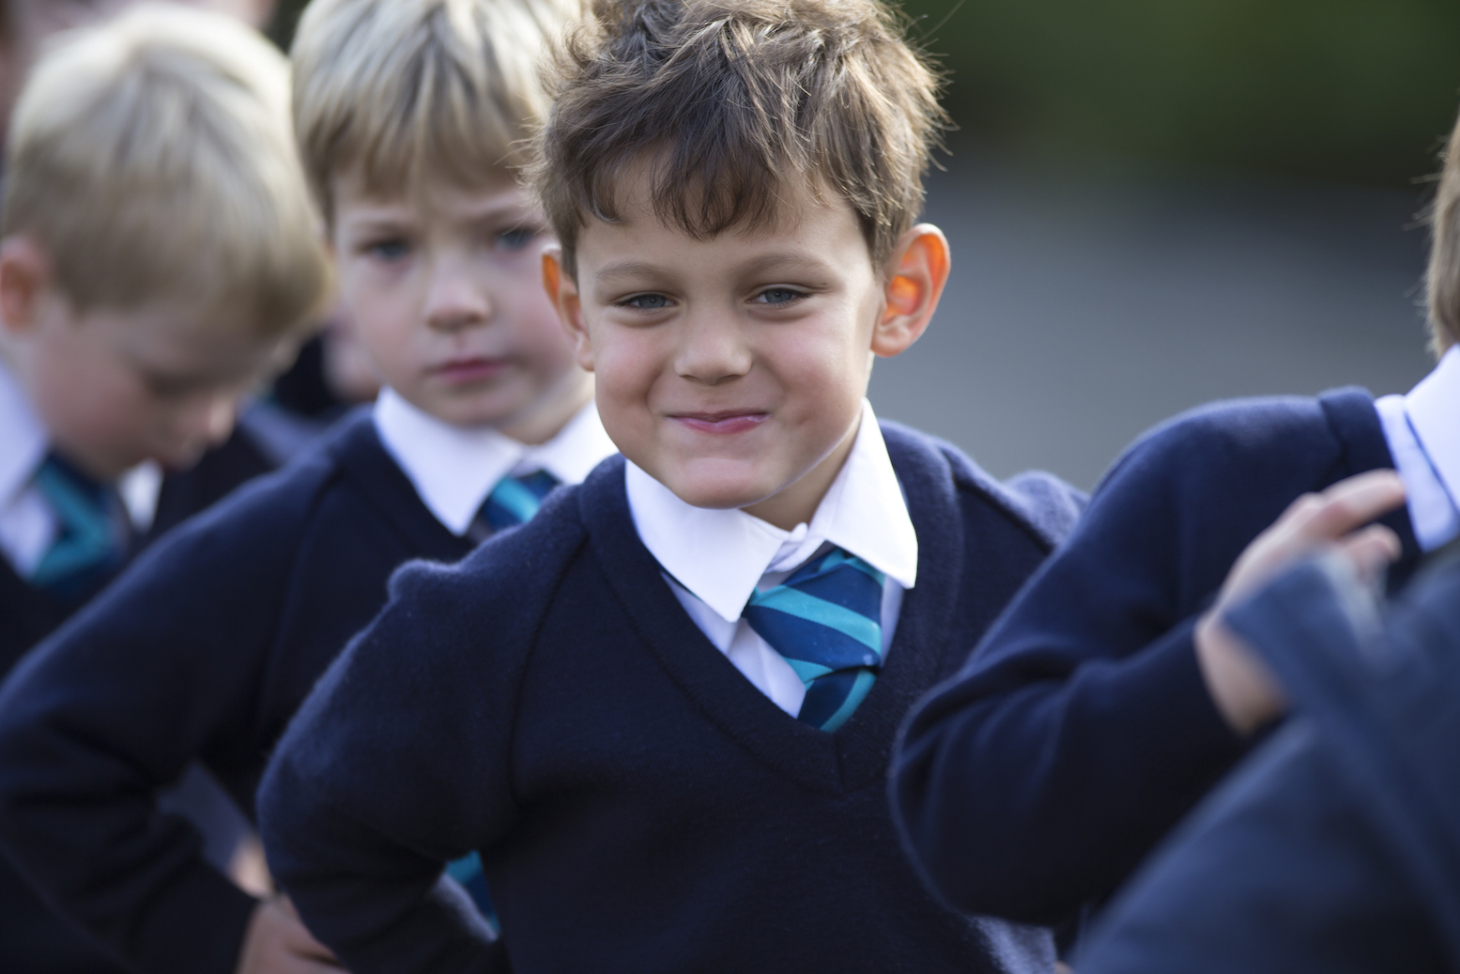
How we show Self Control and Dignity

