Slide 1
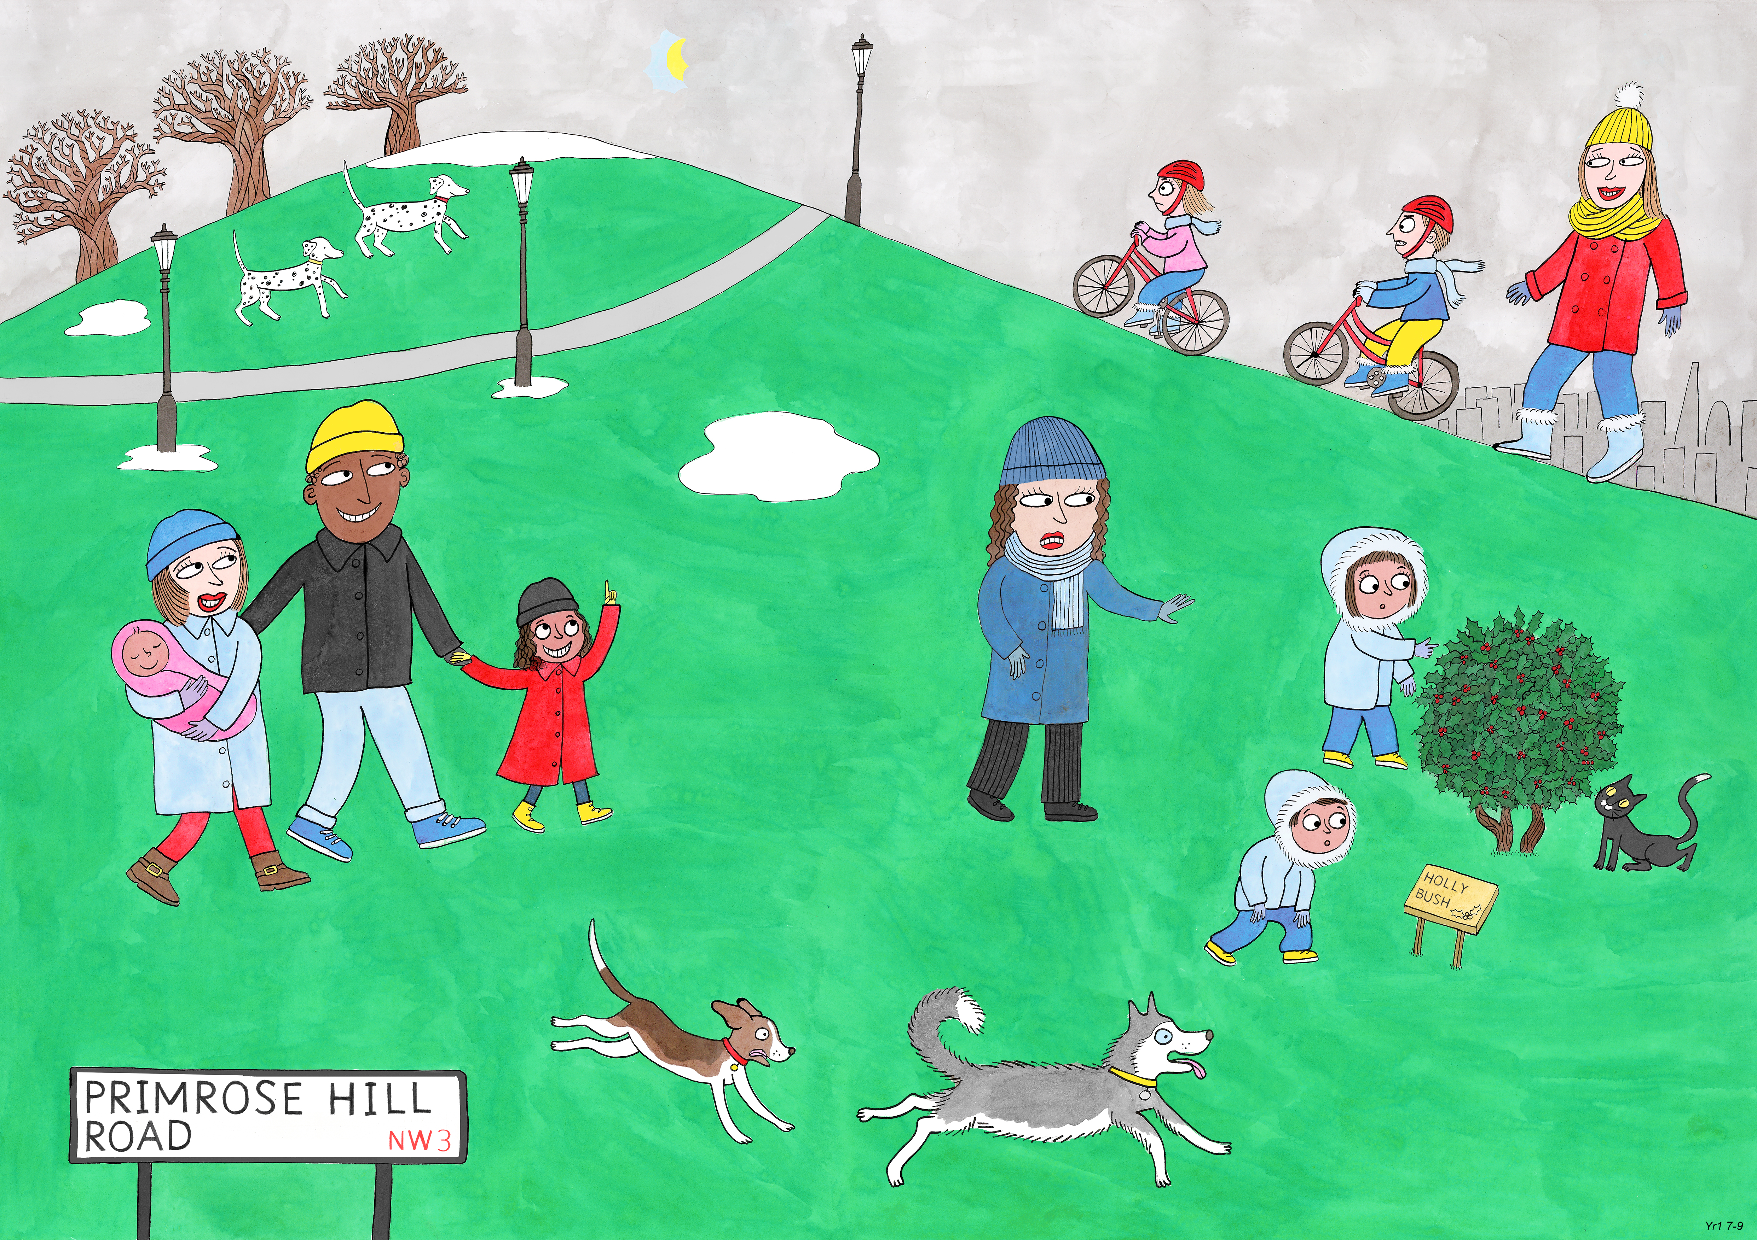
Year 1: Spring 1
Perseverance, Optimism and Joy, Curiosity

