Slide 1

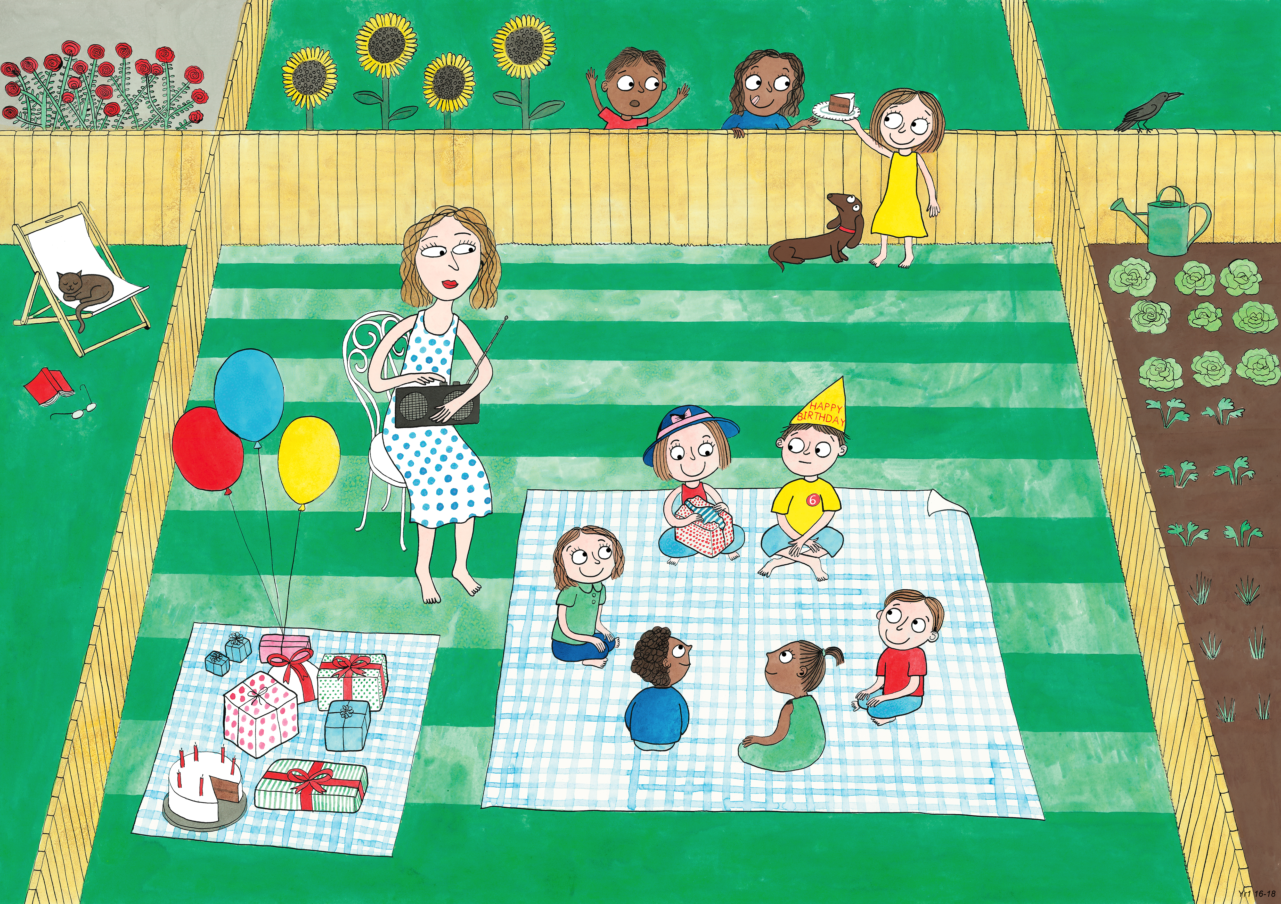
Year 1: Summer 2
Humility, Empathy and Perspective, Gratitude

