Slide 1
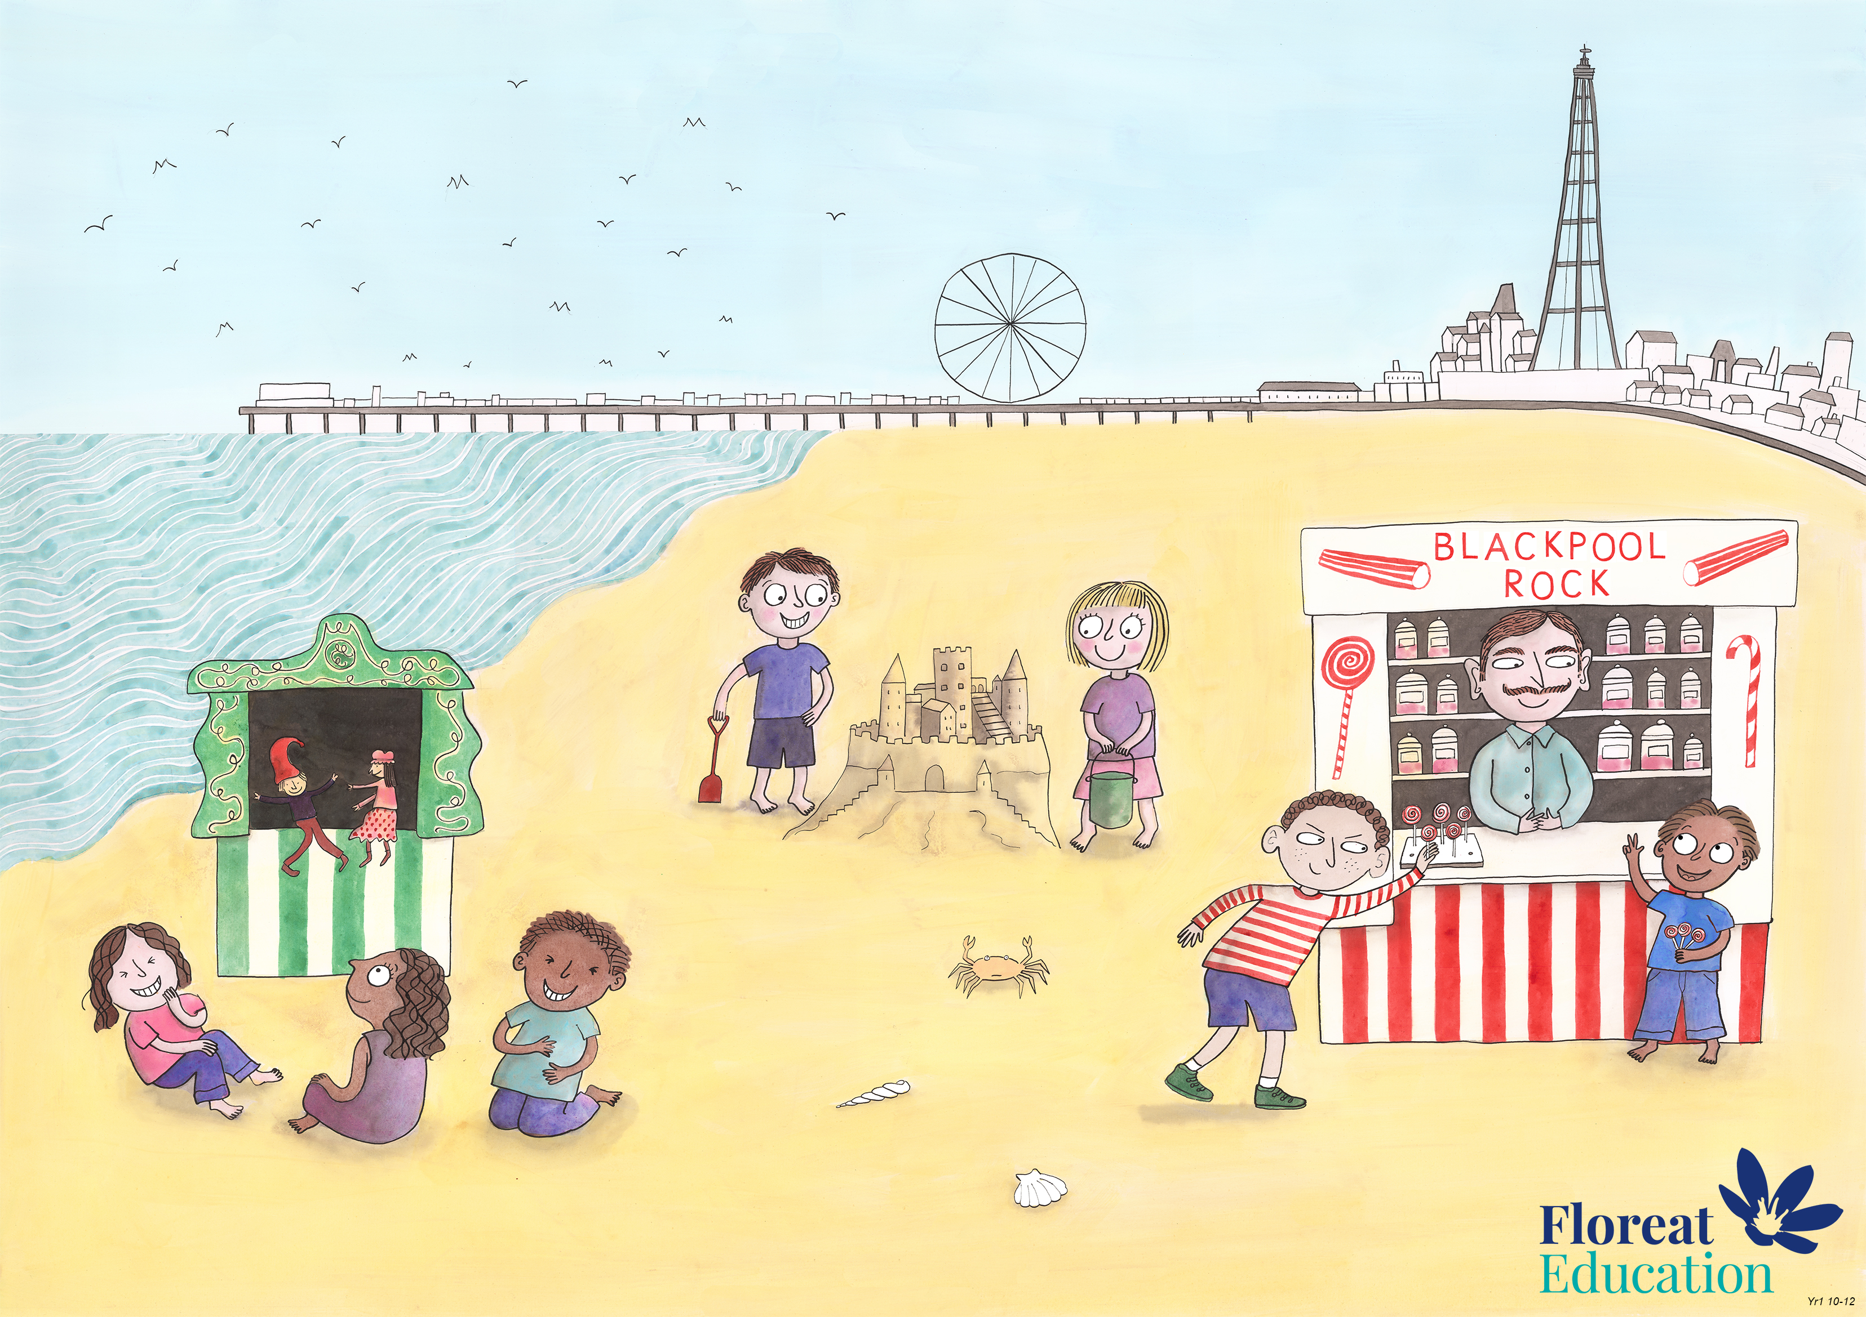
Year 2 Spring 2
Creativity, Honesty, Humour

