Slide 1
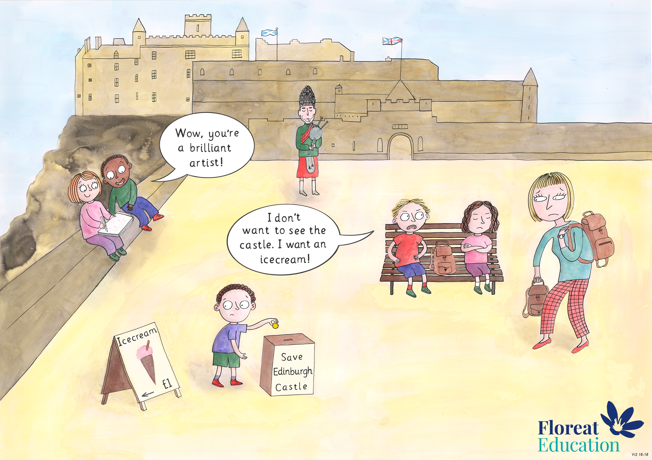
Year 2: Summer 2
Humility, Empathy and Perspective, Gratitude.

